Slide 1
THE ACTIVE PHASE OF NIDA COCAINE COLLABORATIVE TRIAL
Agrima Mahlawat

Slide 2
Introduction
The National Institute on Drug Abuse (NIDA) Collaborative Cocaine Treatment Study was designed to examine the efficacy of four psychosocial treatments for cocaine dependence. This study, carried out between 1991 and 1997, was the largest study ever done on the treatment of cocaine dependence. The focus in this presentation is to identify the factors that significantly influence the Med_sub. The major variables on focus include the socio-demographic variables such as Age, Gender, Education, Employment status and Marital status.

Slide 3
Data Structure
The data set used consists of 2697 observations and 76 variables. Of the 2697 observations 350 pertains to third month sample and 378 to sixth month sample. The analysis were carried out separately for the two time periods. A comparison has been carried out to study the effects at two time points.

Slide 4
Methodology
This study uses descriptive and inferential approaches to compare the results. Descriptive methods include tabulation and diagrammatic representations of measures on Med_sub over the categories of the considered socio-demographic variables. The inferential part includes development of General Linear Model (GLM) using regression approach.

Slide 5
Methodology Cont…
In the General Linear Model ‘Med_sub’ is taken as dependent or response variable and the socio demographic variables as independent or explanatory variables. The independent variables include both categorical and continuous type variables.

Slide 6
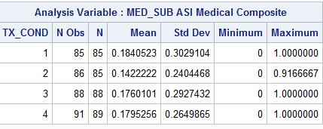
Comparison of Med_sub over intervention type at 3rd month
From the above table, it is seen that the mean for the intervention type ‘1’ has the highest value and that of the ‘2’ has the lowest value.

Slide 7
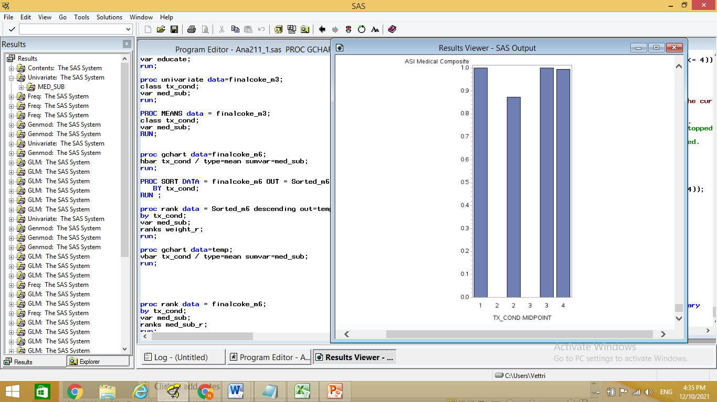
Comparison of Med_sub over intervention type at 6th Month From the below graph, it is seen that the intervention type 2 has the minimum mean for the Med_sub
From the bar graph, it is seen that the Med_sub score does not differ significantly over the different intervention methods.

Slide 8
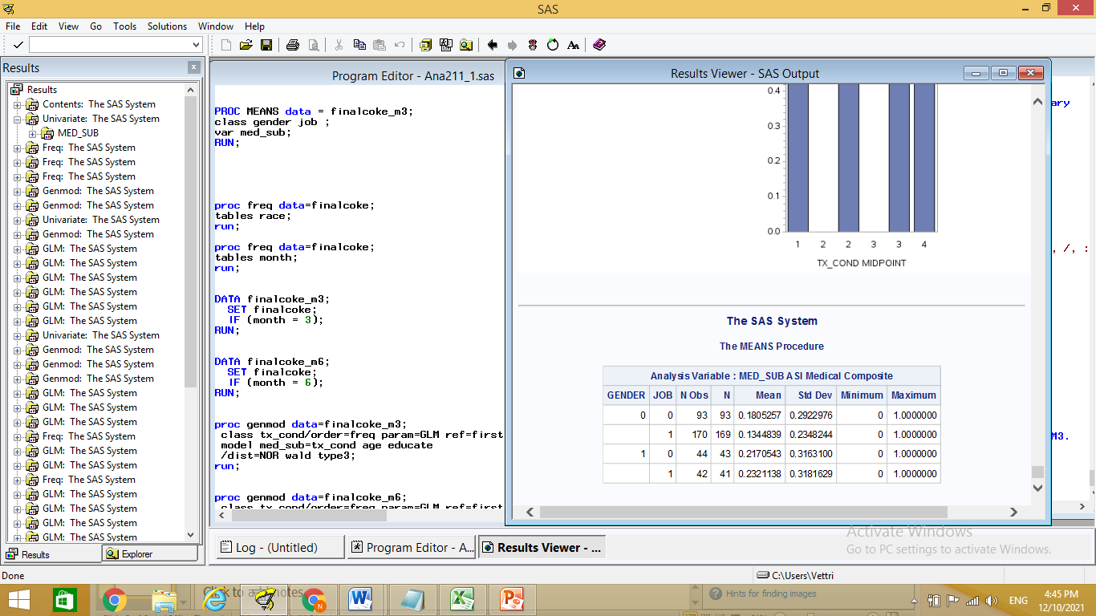
Comparison of Med_sub over gender and job
From the above table, it is seen that males with jobs have the highest Med_sub score and females with job has the lowest score. Thus, this interaction could be taken into the regression model.

Slide 9
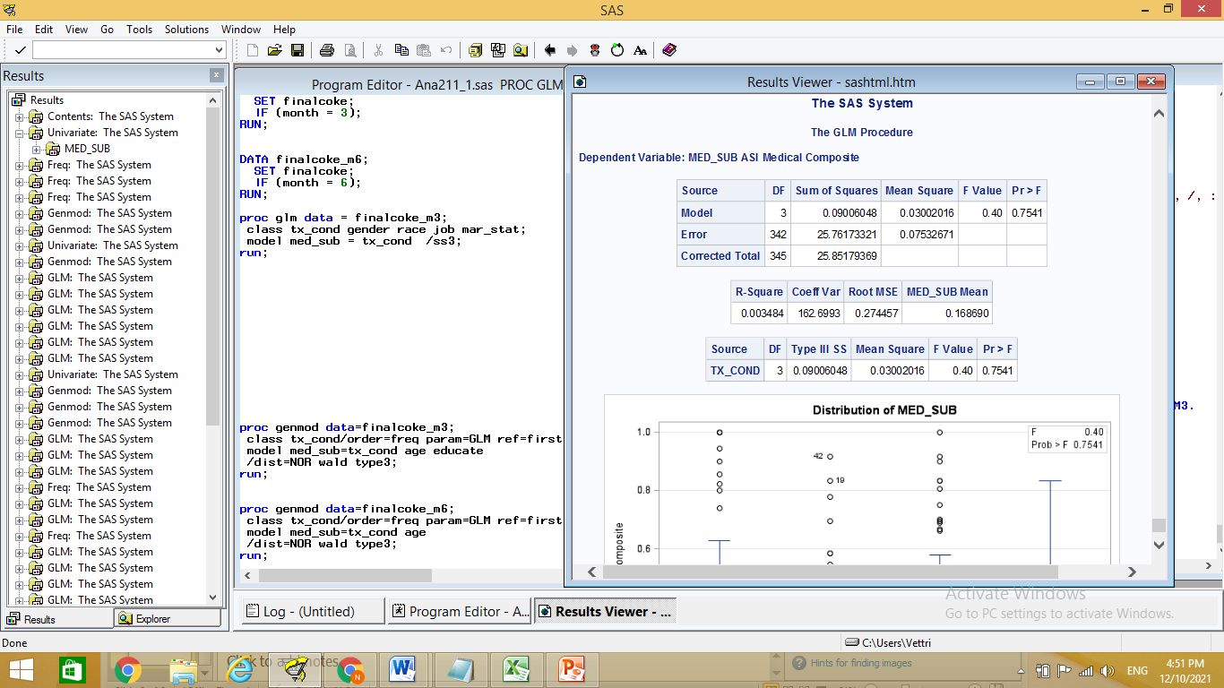
GLM with base model at 3rd Month
From the above GLM results, it is seen that the considered base model is not statistically significant (F=0.4, p>0.05) and that the mean med_sub scores do not differ significantly at the 3rd month with respect to the intervention type.

Slide 10
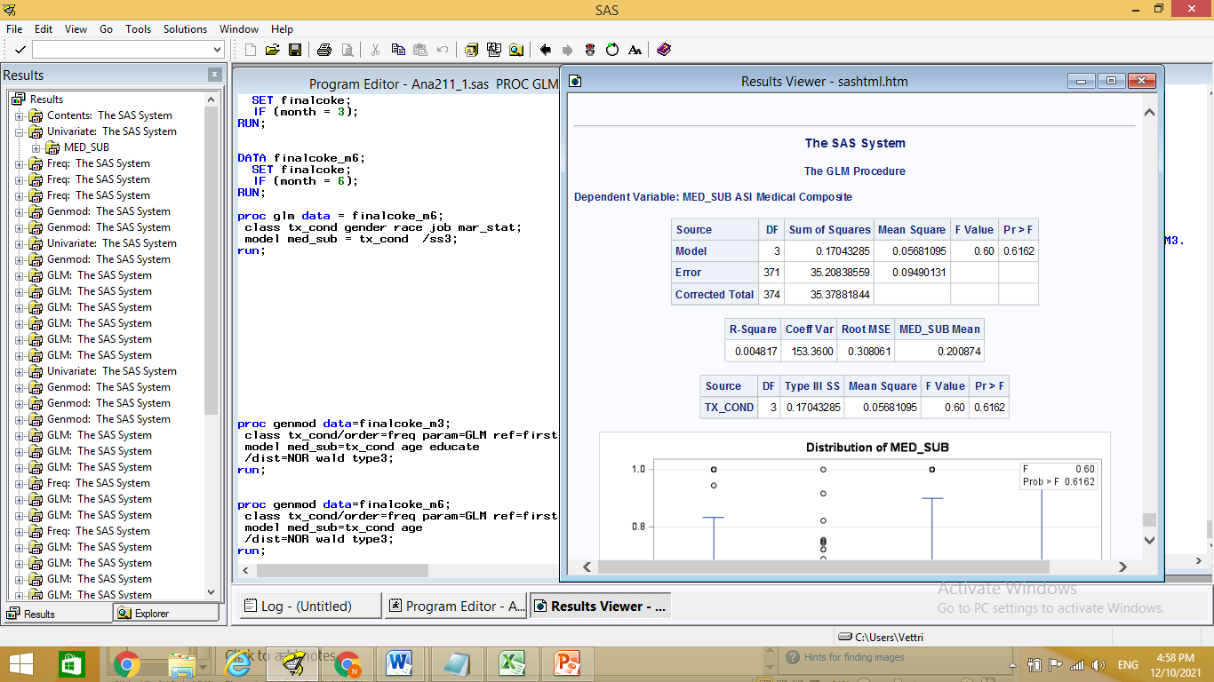
GLM with base model at 6th Month
From the above GLM results, it is seen that the considered base model is not statistically significant (F=0.4, p>0.05) and that the mean Med_sub scores do not differ significantly at the 6th month with respect to the intervention type.

Slide 11
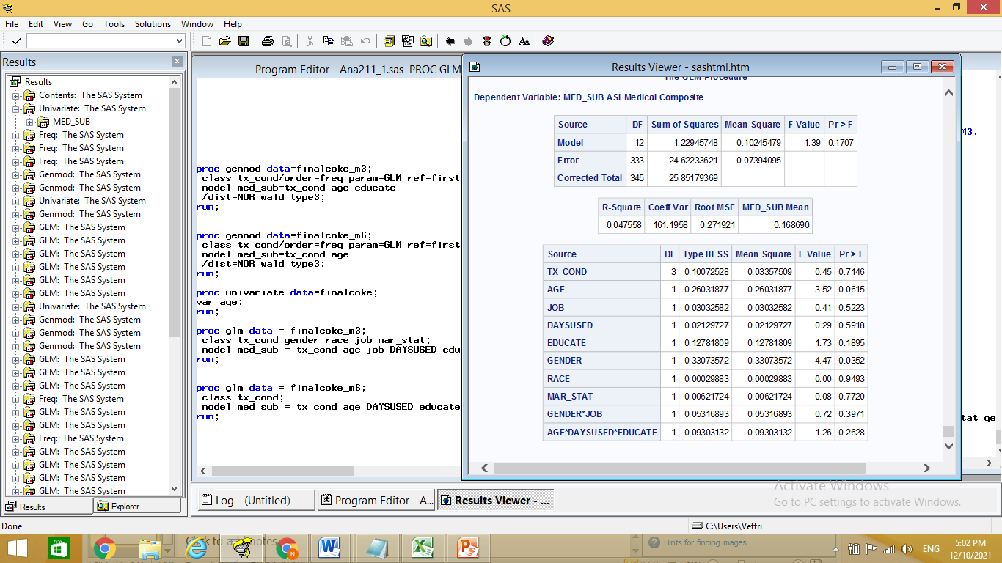
GLM with complete model at 3rd Month
From the above table, it is seen that gender significantly influences (F=4.47, p < 0.05) the Med_sub at 5% level of significance and Age significantly (F=3.52, p < 0.1) influences Med_sub at 10% level. The rest of the variables and the second and third order interaction effects are not statistically significant.

Slide 12
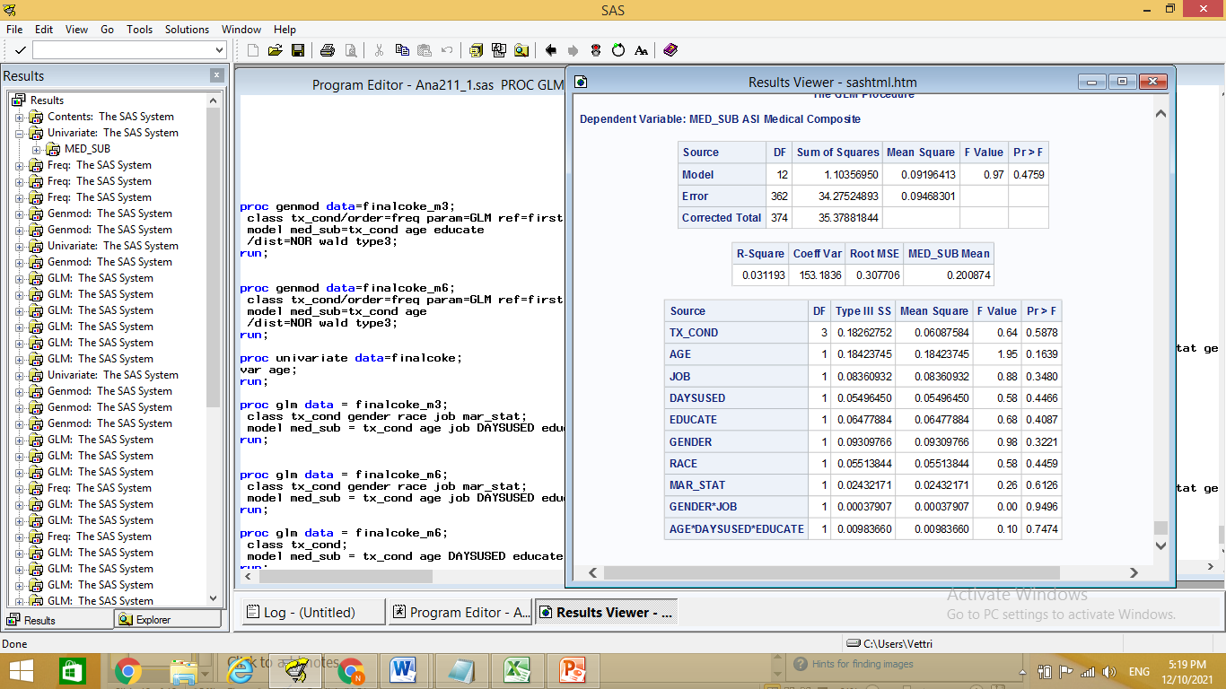
GLM with complete model at 6th Month
From the above table, it is seen that none of the variables significantly influences the Med_sub at the end of 6th month.

Slide 13
Discussion
The impact of different types of intervention programs or treatments are compared with respect the Med_sub measure. Comparison over the intervention types are done individually and after controlling for the socio demographic variables such as age, gender, education, marital status, job status and race. Also some of their second and third order interactions are considered in the model. The model is evaluated both at the 3rd month and at the 6th month.

Slide 14
Discussion (Cont…)
The mean Sub_med scores are compared over selected demographic variables. Univariate and bivariate tabular representations indicate that no big difference could be seen in these measures over the two-way classification considered. Also the graphical representation indicates the same fact. Thus, we proceed with the GLM regression technique to compare the scores after controlling for such variables.

Slide 15
Discussion (Cont…)
The base model includes on the variable of interest, namely, the intervention type and from the regression output, we see that no significant difference could be seen in the mean Med_sub scores with respect to the intervention type. This is so in the 3rd month and as well in the 6th month.

Slide 16
Discussion (Cont…)
The complete model includes on the variable of interest, namely, the intervention type and the other controlling variables such as age, gender, education, marital status and job status. After controlling for these variables and some of their second and third order interactions, we see that only age and gender seems to significantly influence the Med_sub score at the 3rd month. None of the variables influence significantly in the 6th month.

Slide 17
Conclusion
The study that considers 350 observations from the 3rd month and 378 observations from the 6th month concludes that the intervention type does not significantly alter the Sub_med score both at the 3rd and 6th month. The impact of intervention is also very minimal, when the model is being controlled with other related socio-demographic variables. On the whole we see that all the intervention types have similar results, so far as the Med_sub score is concerned.

Slide 18
References
Birkes, David and Dodge, Y., Alternative Methods of Regression. ISBN 0-471-56881-3
David A. Freedman (27 April 2009). Statistical Models: Theory and Practice. Cambridge University Press. ISBN 978-1-139-47731-4.
Draper, N.R.; Smith, H. (1998). Applied Regression Analysis (3rd ed.). John Wiley. ISBN 978-0-471-17082-2.
Fox, J. (1997). Applied Regression Analysis, Linear Models and Related Methods. Sage
Hardle, W., Applied Nonparametric Regression (1990), ISBN 0-521-42950-1

